Slide 1

LIBRARY MANAGEMENT SYSTEM
This presentation will explore the design and implementation of a LIBRARY MANAGEMENT SYSTEM, including its key features, user interface, and integration with database technology.
BN
by Bharkavi N 231801023
DEPARTMENT OF ARTIFICIAL INTELLIGENCE AND
DATASCIENCE

Slide 2

Abstract
Project Overview
Key Technologies
A user-friendly software solution designed to manage library operations, including book cataloging, member registration, borrowing, and returning.
Leveraging Java JDK, XAMPP, MySQL, and MySQL Connector to create a robust and efficient system.
Benefits
Streamlining library processes, improving efficiency, and enhancing user experience through a user-friendly interface.

Slide 3
Introduction
Problem Statement
Solution
Traditional library management systems can be cumbersome and time-consuming, leading to inefficiencies and difficulties in tracking resources.
This project aims to develop a modern LIBRARY MANAGEMENT SYSTEM that addresses these challenges by providing a user-friendly interface and streamlined functionality.

Slide 4
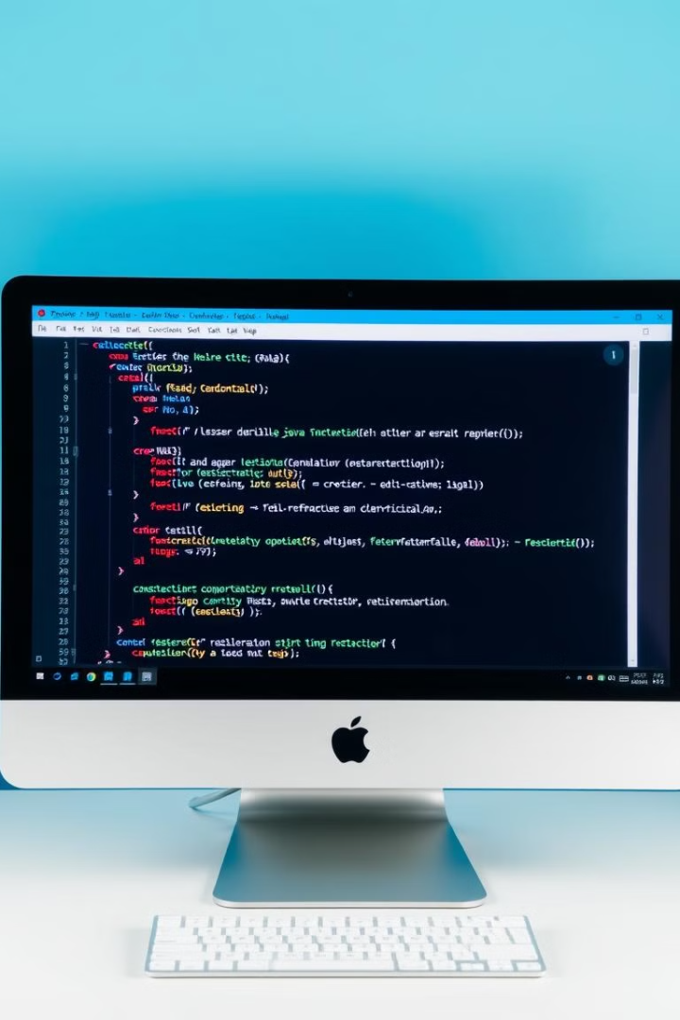
UI Design using Java JDK
Swing Framework
User-Centered Design
Utilizing Java Swing for creating a visually appealing and intuitive user interface with components like buttons, text fields, and tables.
Prioritizing ease of use and user experience through a clear and consistent layout, intuitive navigation, and simple interaction.
Code Optimization
Employing Java coding best practices to ensure efficiency, maintainability, and readability of the code base.

Slide 5
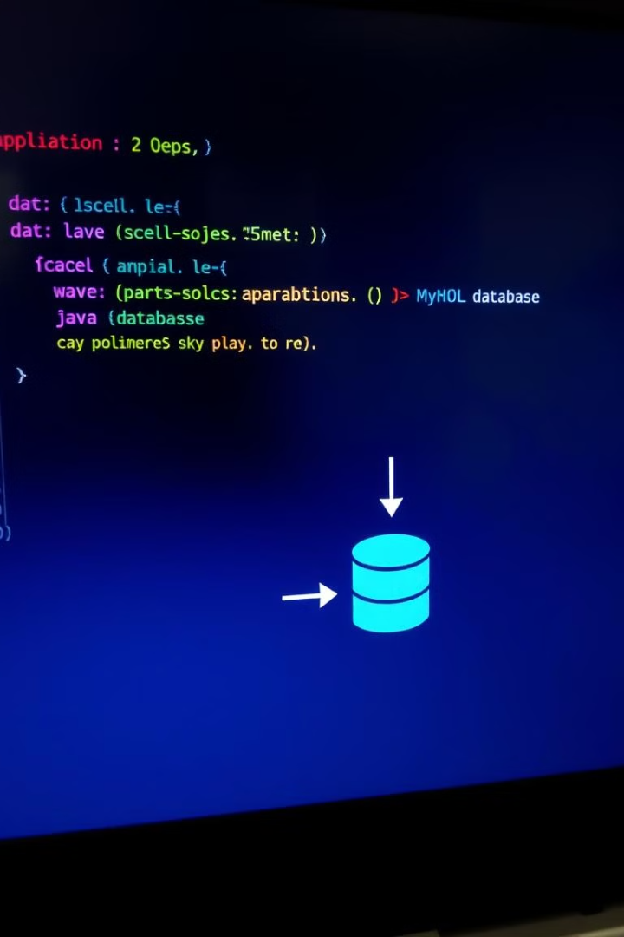



Integration with XAMPP and MySQL
MySQL Database
Utilizing a relational database management system (MySQL) to store and manage library data, including books, members, and borrowing records.
XAMPP Server
Leveraging XAMPP for local server setup and management, providing an environment for running and testing the application.
MySQL Connector
Using the MySQL Connector Java library to establish a seamless connection between the Java application and MySQL database.

Slide 6
Implementation: User Registration Form
Form Design
Data Validation
Database Insertion
Designing a user-friendly form with clear labels, input fields, and error handling mechanisms to ensure accurate data collection.
Implementing data validation checks to ensure the integrity of user data, preventing invalid or incomplete submissions.
Upon successful registration, the user's data is securely stored in the MySQL database, creating a new member record.

Slide 7
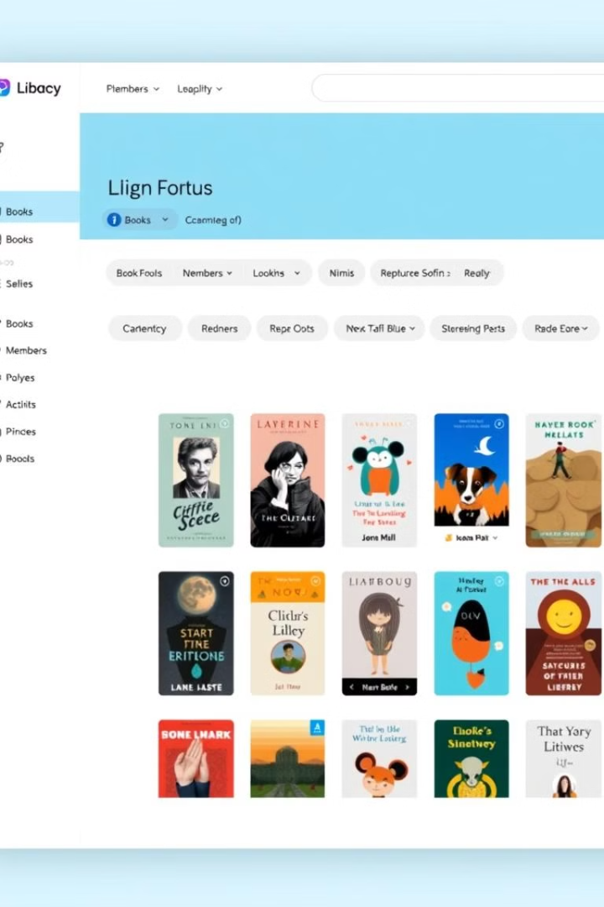



Implementation: Library Management System Page
Dashboard Overview
Providing a central hub for accessing key library information, including recently added books, active members, and overdue books.
Navigation Menu
Implementing a clear and intuitive navigation menu for easy access to different sections of the system, including book management, member management, and reports.
Search Functionality
Enabling users to quickly find books or members using keyword searches or filter options.

Slide 8
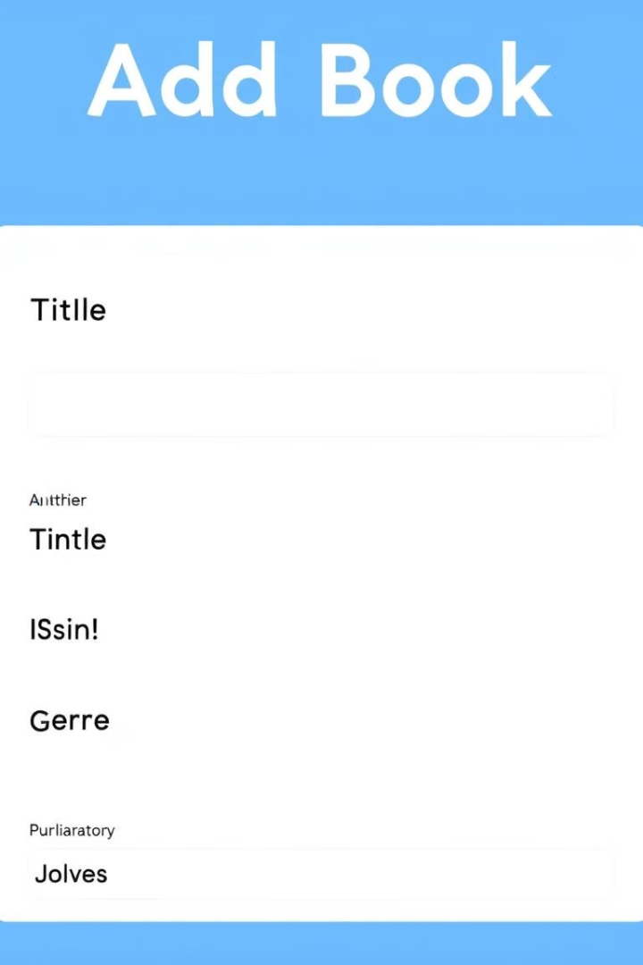
Implementation: Add Book Functionality
1
Book Details
Collecting essential book information, such as title, author, ISBN, genre, publication date, and availability status.
2
Data Validation
Validating user input to prevent errors and ensure data integrity before saving the book information.
3
Database Insertion
Adding the new book information to the MySQL database, creating a new entry in the books table.

Slide 9



Results
Improved Efficiency
1
Automating library processes reduces manual effort and streamlines operations.
Enhanced User Experience
2
A user-friendly interface makes it easy for staff and members to access and manage information.
Accurate Data Management
3
The system ensures accurate and reliable data management, reducing errors and inconsistencies.

Slide 10
Discussion
Future Enhancements
1
Exploring features like book recommendations, overdue notifications, and advanced search capabilities.
Scalability and Security
2
Addressing scalability and security considerations to ensure the system can handle future growth and protect sensitive data.
User Feedback
3
Gathering user feedback and implementing improvements based on suggestions to optimize the system's usability.

